Slide 1
UX/UI Design
TAMID Tech Track

Slide 2
What is UX/ UI?
UX (user experience) = A person's emotions and attitudes about using a particular product, system or service. It includes the practical, experiential, affective, meaningful and valuable aspects of human–computer interaction and product ownership.
UI (user interface) = anything a user may interact with to use a digital product or service. This includes everything from screens and touchscreens, keyboards, sounds, and even lights.
A UX/UI Designer works on a product team to consider and achieve both business and user goals within a platform. UX decisions are driven by data collected by researching and testing products with real users at all stages of a product life cycle and constantly iterating on designs to improve them!
Video Link

Slide 3
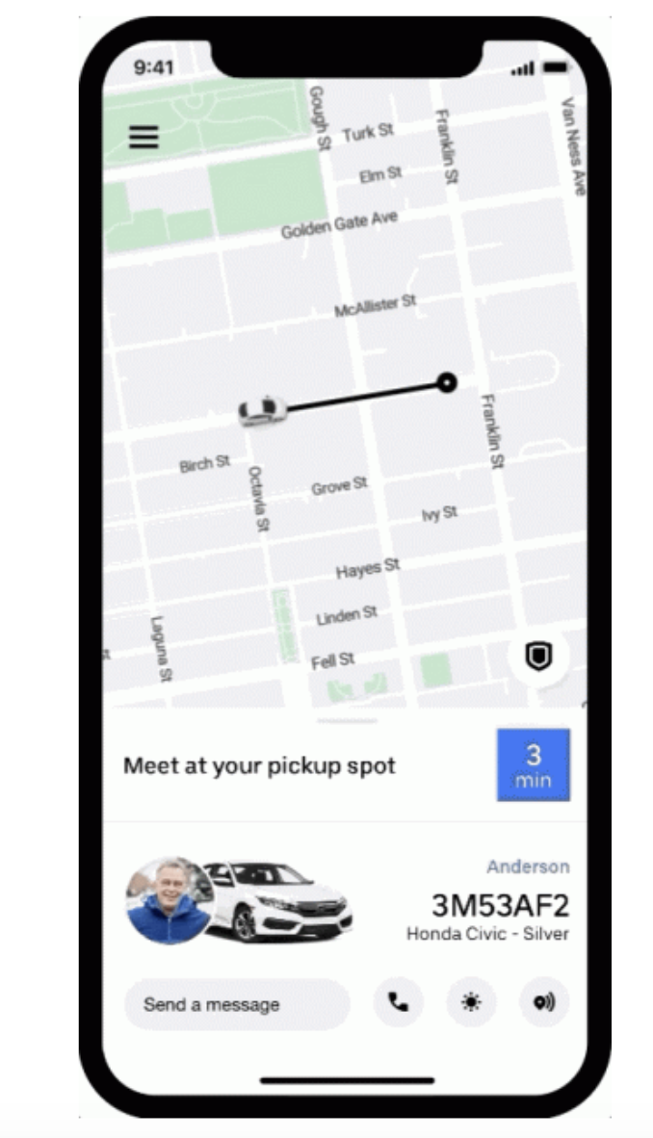
UX Example
Iteration
Business Problem:
Uber is losing revenue due to
users canceling rides
Research:
Uber surveys, interviews, and observes users to determine the root of the problem. They see that many users cancel rides when the wait is too long or they cannot find the car
Design:
Uber creates features that:
Show users where the car is
Allow user-driver call and text communication
Show updated wait times
adding transparency to wait time and pickup location

Slide 4
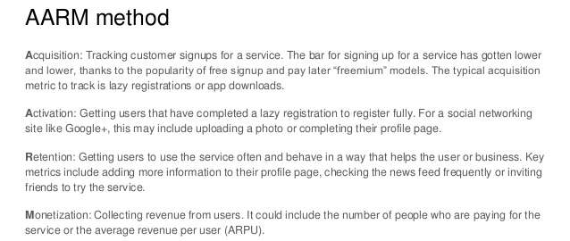
Metrics
Metrics are key data points that indicate problems or success on a platform. Metrics can be sorted into the AARM Framework:

Slide 5
UX Research Methods
Video Link
UX researchers & designers combine several methods to gather user feedback to understand their preferences
Interviews
Asking users questions to understand their backgrounds, pain-points, and preferences
Interviews
Card Sorting
Card Sorting
Displaying several topics or components of a system and asking users sort and to categorize the content
Surveys
Set of questions used to collect topic-specific information from a representative sample of your target audience
Surveys
Usability
Usability Testing
Observing participant’s behavior and listens for feedback when interacting with product
A/B Testing
Experiment where two or more variants of a page are shown to users at random, and statistical analysis is used to determine which variation performs better for a given conversion goal.
A/B

Slide 6
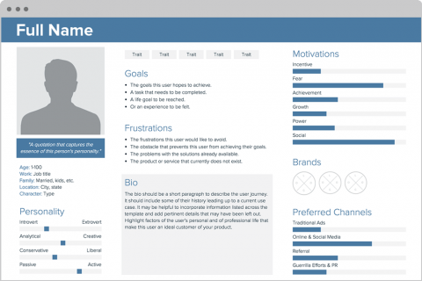
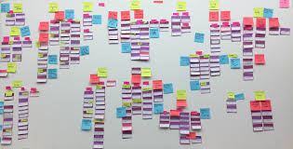
Making Sense of the Data
Personas
Affinity Diagrams
The purpose of personas is to create reliable and realistic representations of your key audience segments for reference. This is necessary for inclusive design! These representations should be based on qualitative and some quantitative research and data
Organize data into key findings/ ideas. Usually done after user interviews or participatory design

Slide 7
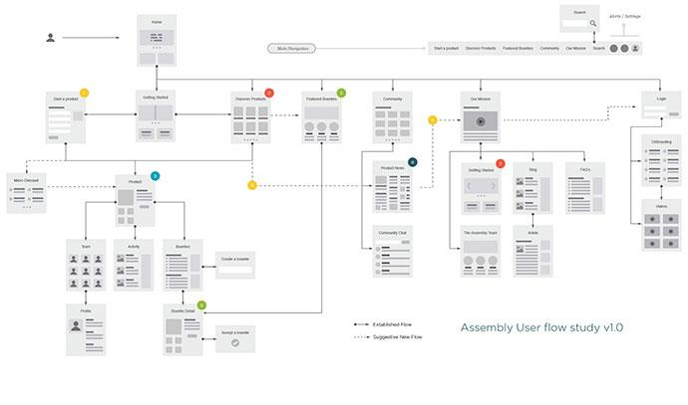
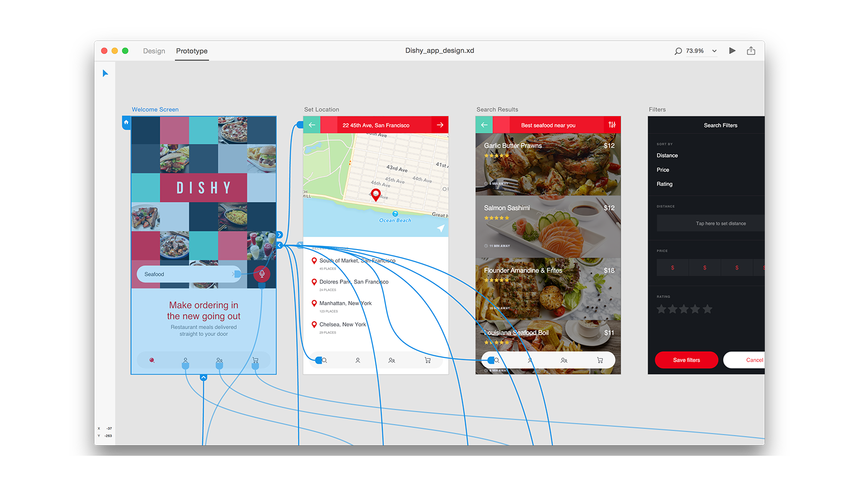
Prototyping
Prototypes are key to planning products and creating/ testing user experience.
Low Fidelity
High Fidelity
Wireframes map out user flow, or the path taken by a prototypical user on a website or app to complete a task.

Slide 8
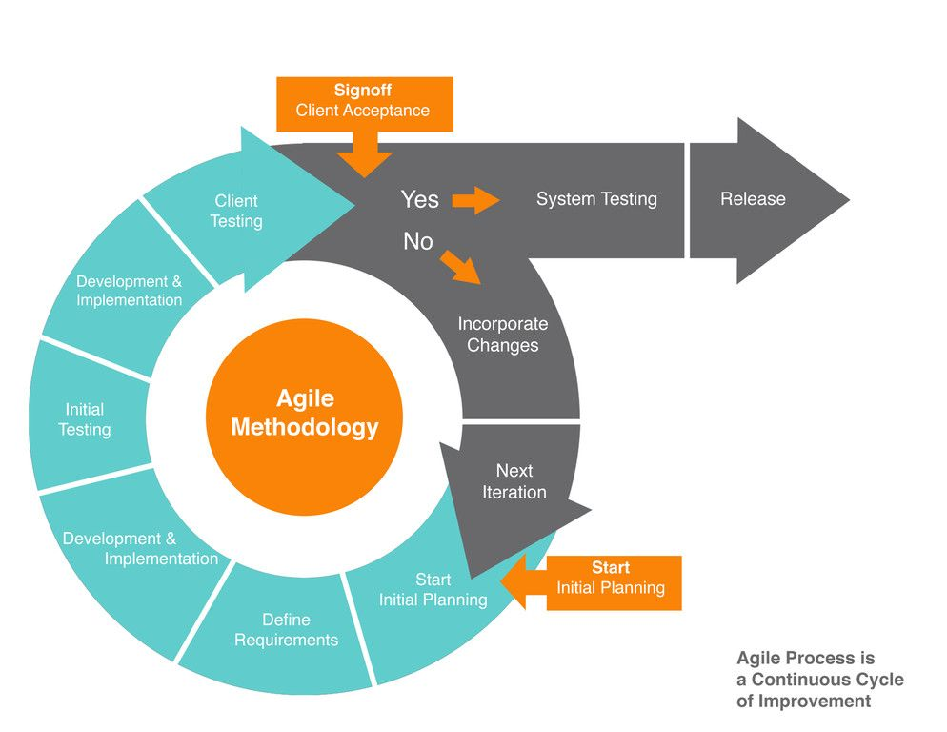
Agile Iteration
UX Designers must work in Agile, cycling through the design process at all development stages to ensure delightful, frustration free UX

Slide 9
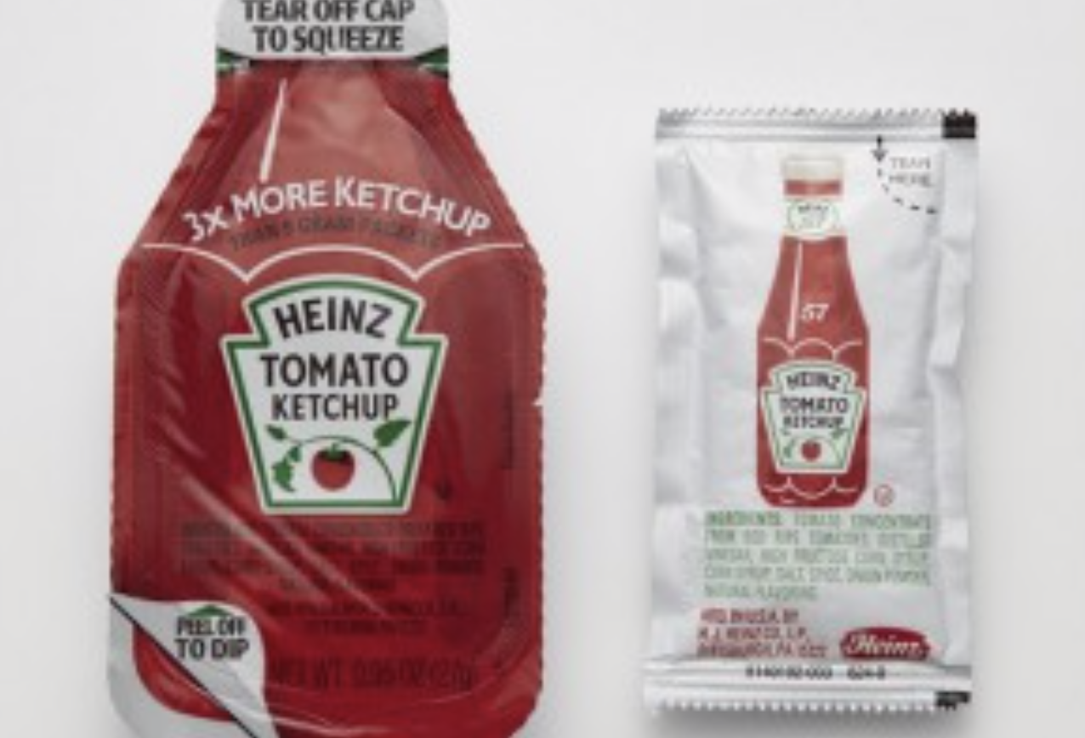
Good vs. Bad UX
Good
Easy
Frustration-free
Beautiful
Simple
Innovative
Inclusive
Accessible
Various devices & servers
Different abilities, income, experience
Bad
Difficult
Frustrating
Ugly
Bland
Complicated
Outdated
Inaccessible
Discriminatory

Slide 10
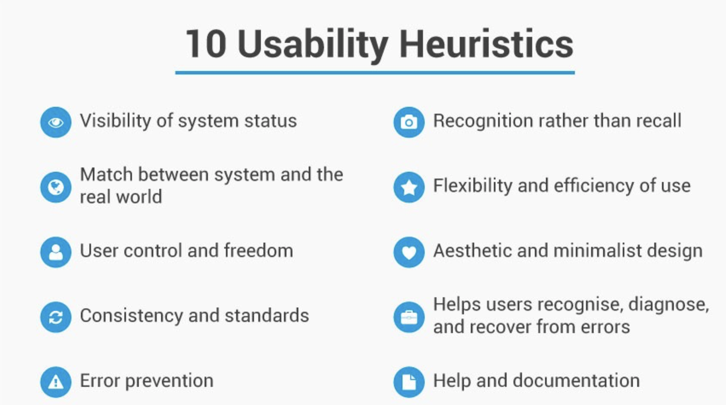
Neilsen’s 10 Heuristics
Heuristic Analysis is a framework experts use to evaluate UX of a system or product.
Link to heuristics in depth

Slide 11
UX/ UI Careers
UX Design has many different career paths:
UX/UI Designer
This can be pretty different at different companies. For example, many startups have one person doing research, visual design, AND web development, while larger companies may have distinct roles for each
UX/UI Researcher
Product Manager
Experience Consultant
Interview Prep
Create a design portfolio
Read “Decode and Conquer”
Note: You do NOT need to be good at graphic design, web design, or coding to go into UX. Try different areas within the field to see what your calling is!

Slide 12
Activity
In a group, copy this chart to describe 5 heuristic violations of an app on your phone. Then, select which UX methods you would use to start solving these problems and how.
Link

Slide 13
More Practice Questions
How would you design Spotify for the blind?
How would you redesign the LinkedIn profile page?
What metrics would you use when redesigning the Facebook news feed?
What is the most important metric?

